Slide 1
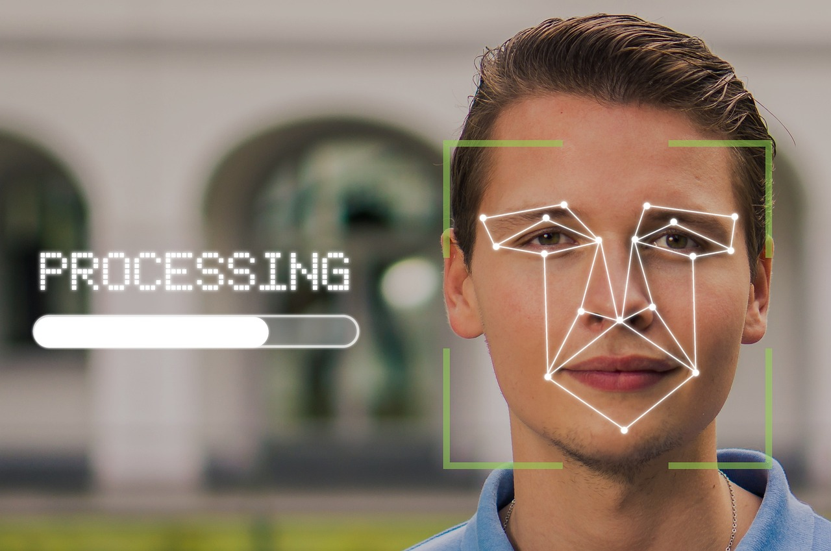

Multi-Biometric Authentication System
Arpat Rodpai; Gabriel Gorospe

Slide 2
Overview
Our team selected Multi-Biometric Authentication System design because our background related to Cybersecurity, Artificial Intelligence, and Digital system design.
Specifically, we focus on morphological biometrics involving the physical traits of the user including fingerprint and face scans. The system uses machine learning algorithms to authenticate users based on training from previously gathered biometric data.
The project uses an Arduino microcontroller as the main platform for our embedded system. Additionally, the major hardware components are the optical finger print scanner and a high-definition webcam mounted to a PC. The complete part list can be found in the BOM.

Slide 3

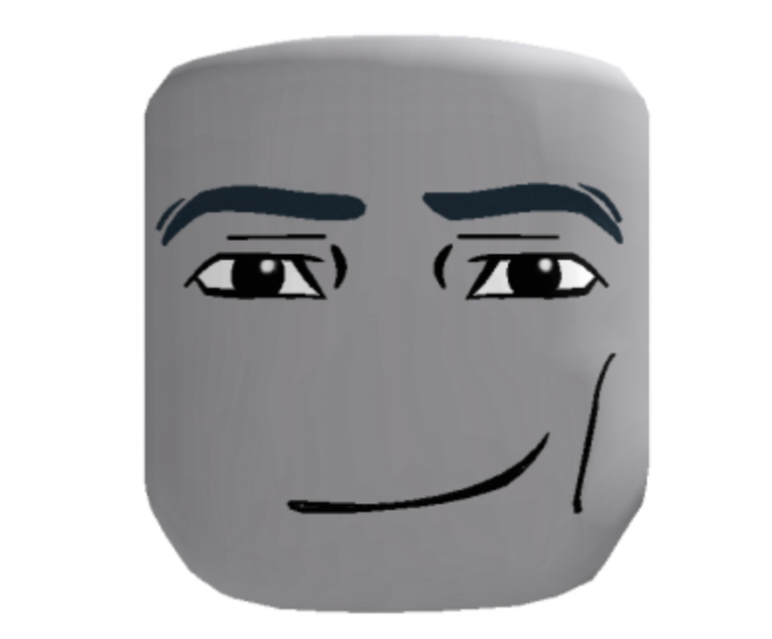
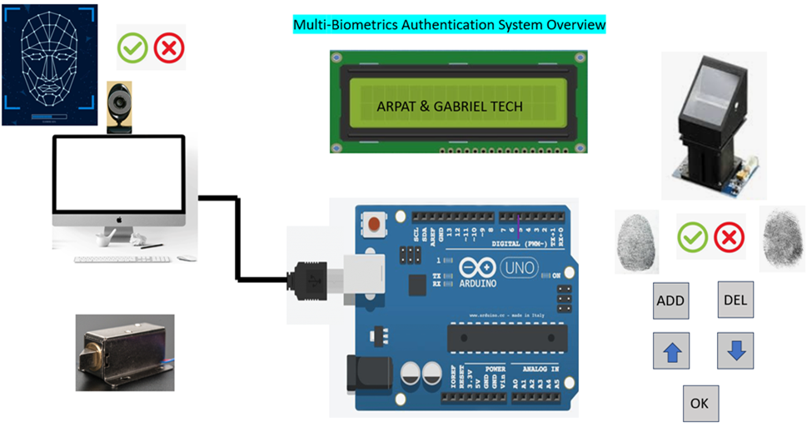
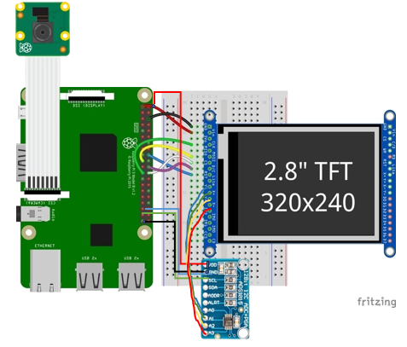
Concept of Operation

Slide 4
Concept of Operation 1
Fingerprint Scanner Integration
The Arduino can be used to send the command to the fingerprint scanner module (RS305), which in turns provide several tasks, such as scanning, storing finger print data, and matching the figure print. Then, the scanner will provide acknowledgement to the Arduino. Finally, the Arduino displays result to the 16 x 2 LCD screen (1602A).
User Enrollment
A new user must enroll his/her fingerprint by placing his/her finger onto the scanner twice. The finger scanner turns the figure print into the template and store it.
Authentication Process
For the authentication, a user can place his or her finger. Then, the Arduino requests a matching fingerprint to the fingerprint module. The fingerprint module compares the incoming template with its on template library, and return the result to the Arduino. Finally, the Arduino displays the result on the 16 x 2 LCD screen and send a signal to unlock the door

Slide 5
Concept of Operation 2
Authentication Process
For the authentication, a user can place his or her finger. Then, the Arduino requests a matching fingerprint to the fingerprint module. The fingerprint module compares the incoming template with its on template library, and return the result to the Arduino. Finally, the Arduino displays the result on the 16 x 2 LCD screen and send a signal to unlock the door.
Template Management
if a user is no longer work for a company, his or her template can be removed from the library, by selecting the delete button. The up and down button can be used to navigate the library and OK button can be used to confirm the figure print template ID,
Facial Recognition
Finally, the facial recognition can be used as a second authentication. A user must have his or her face capture in the security office as part of facial registration. Then, the data is stored inside the computer. This process requires a security officer to assist a user. When a user requests an access, a security office can activate the facial comparison. The result can be sent via a serial communication. The matching image can result in sending a ‘1’ message to Arduino, which in turns display the result on the LCD and unlock the door.

Slide 6
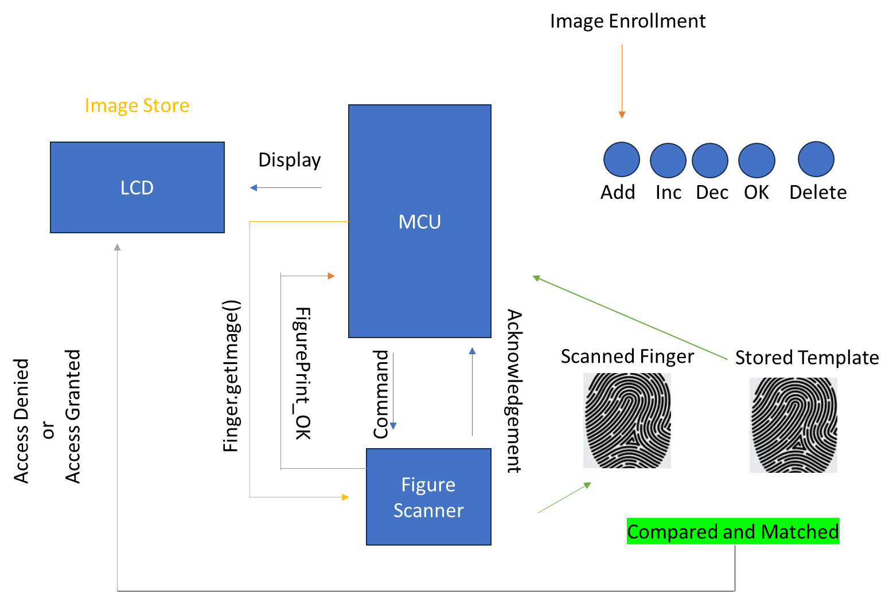

Fingerprint Authentication Process

Slide 7
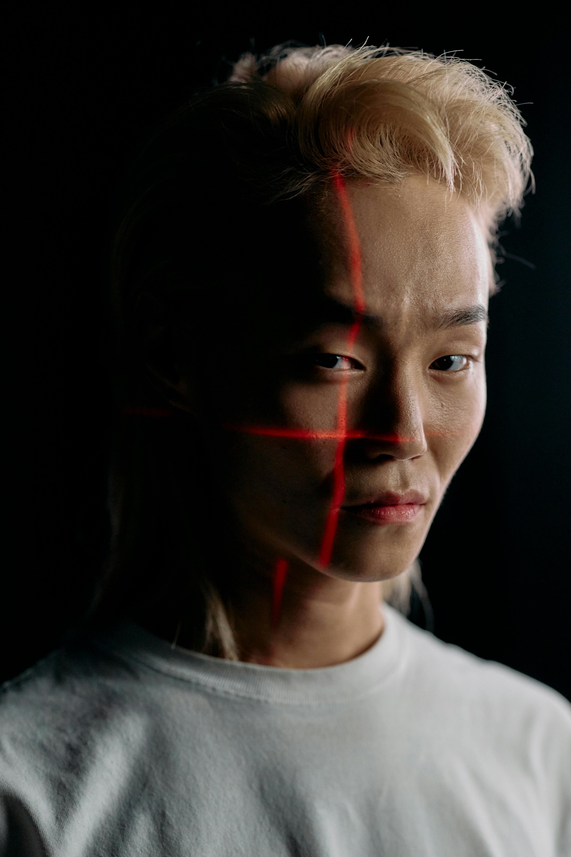
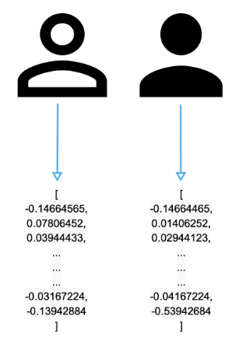
Facial Recognition Process
Load Image from database
cv2.imread(‘image.jpg)
Transform Image into digital Information
face_recognition.face_encoding(image, location)
Perform facial recognition
face_recognition.compare_faces( )
Capture frame by frame from
Webcam. Cv.VideoCapture()
, video_capture.read()
Transform Image into digital Information
face_recognition.face_encoding(image, location)
Simplified the image
cv2.cvtColor(frame,cv.color_bgr2bgb)
Identified facial location on the image
face_recognitoin.face_location( )

Slide 8

Component Specification and Description

Slide 9
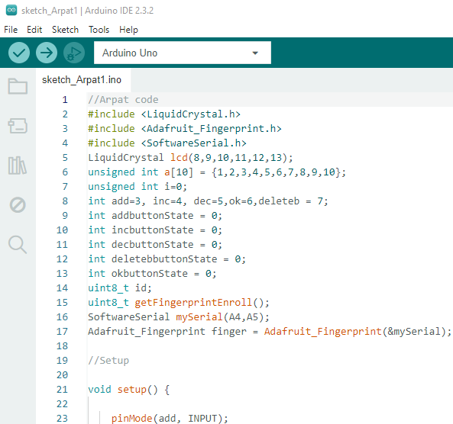

Host Operating System
Manages facial scanning by enabling a video camera and capturing a specified number of facial images, and comparing to template
Utilizes Python with OpenCV, Facial Recognition, and Serial library to format images and execute algorithmic operations with templates

Slide 10
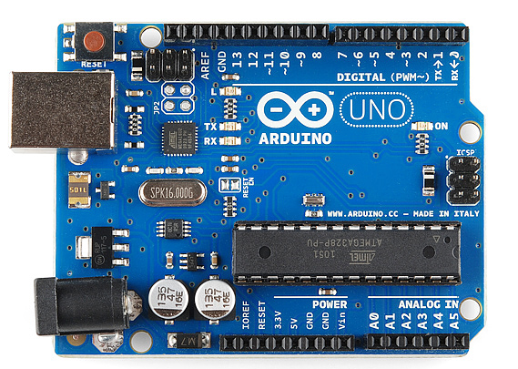
Arduino Uno
Controller for hardware peripherals including fingerprint scanner, door lock, and LCD
Serial communication with hardware peripherals using on-board pins
Serial communication with host operating system over USB connection

Slide 11
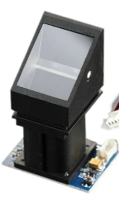
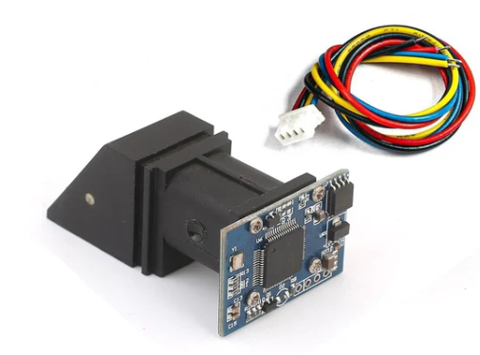
Finger Print Scanner
Optical image capturing with resolution up to 500 dpi
The onboard FLASH memory can store up to 120 finger prints
Integrated image collecting and algorithm chip
Connects to Arduino with TTL serial interface
Utilizing Adafruit Fingerprint library
Working Current @ Voltage: < 120mA @ DC3.6 ~ 6V
Dimension: 56x20x21.5 mm
The high powered DSP chip AS601 that is capable of perform
image rendering, calculation, feature-finding and searching

Slide 12
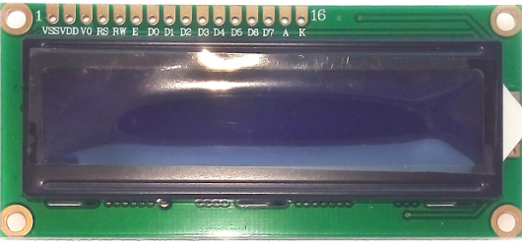
LCD Display (16 x 2)
Used to display human readable messages for the user
16 pixelated character positions for each row, 2 rows
Connects to Arduino with 4-bit parallel interface
Supply voltage: 5 V
Dimension: 80mm x 35mm x 11mm
Utilizing LiquidCrystal library for Arduino
Display ASCII characters

Slide 13
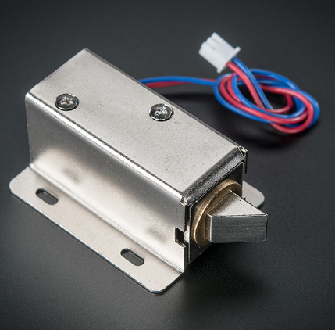
Lock-style Solenoid
Unlocks when 9-12V is applied, and remains locked when no voltage is applied.
Features a slug with a slanted cut and mounting bracket for conventional doors.
When the voltage is applied, the slug
pulls in so it doesn’t stick out and the door
can be opened

Slide 14
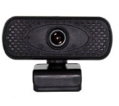
High-Definition Webcam
1080p webcam Connected to host operating system over USB
Windows Operating System
Dimensions: 5 x 4 x 2.75 inches
PC Platform

Slide 15
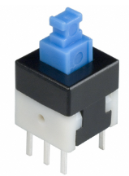
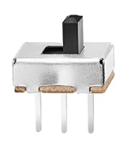
SPST and Push Button
Single-Pole Single-Throw is used for turn on and off add and delete functions
Push button switches control up and down and OK functions

Slide 16
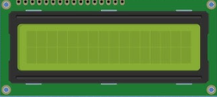
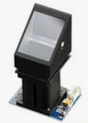
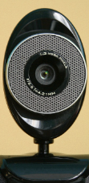
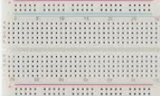

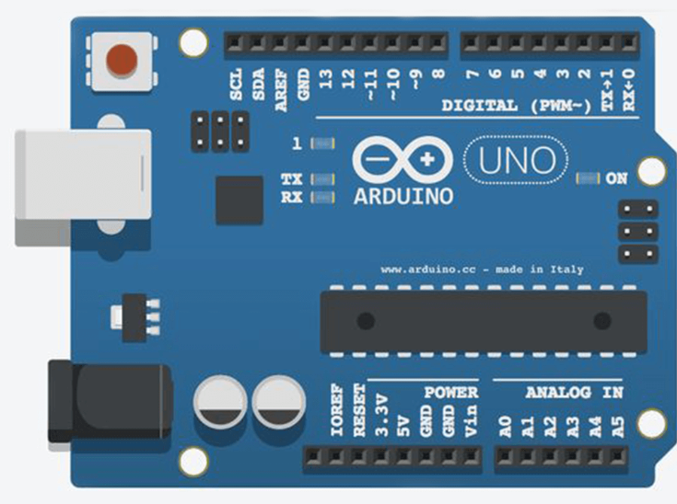
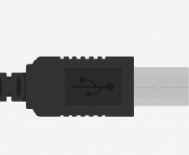
ARPAT & GABRIEL TECH
OK
ADD
DEL

Slide 17
BOM
Part Name | Par Number | Total Quantity | Unit Cost
Arduino Uno | A000066 | 1 | $27.60
Arduino USB Cable | FZ0932X2 | 1 | $13.99
Finger Print Scanner | RS305 | 1 | $24.99
LCD Display (16 x 2) | LCD 1602A | 1 | $8.38
Lock-style Solenoid | 1512 | 1 | $24
High-Definition Webcam | ZC-PP1 | 1 | $10
SPST Switch | SS12D00G | 2 | $0.5
Push Button | EG1872-ND | 3 | $3
112.46 + cost of PC

Slide 18
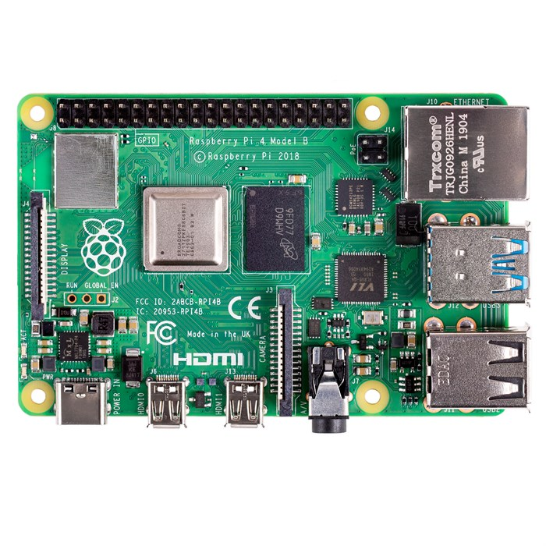
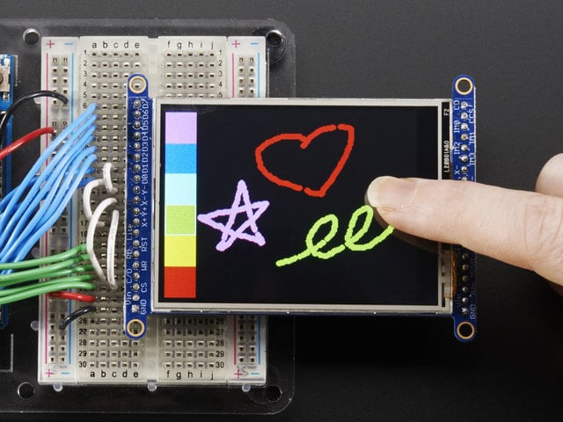
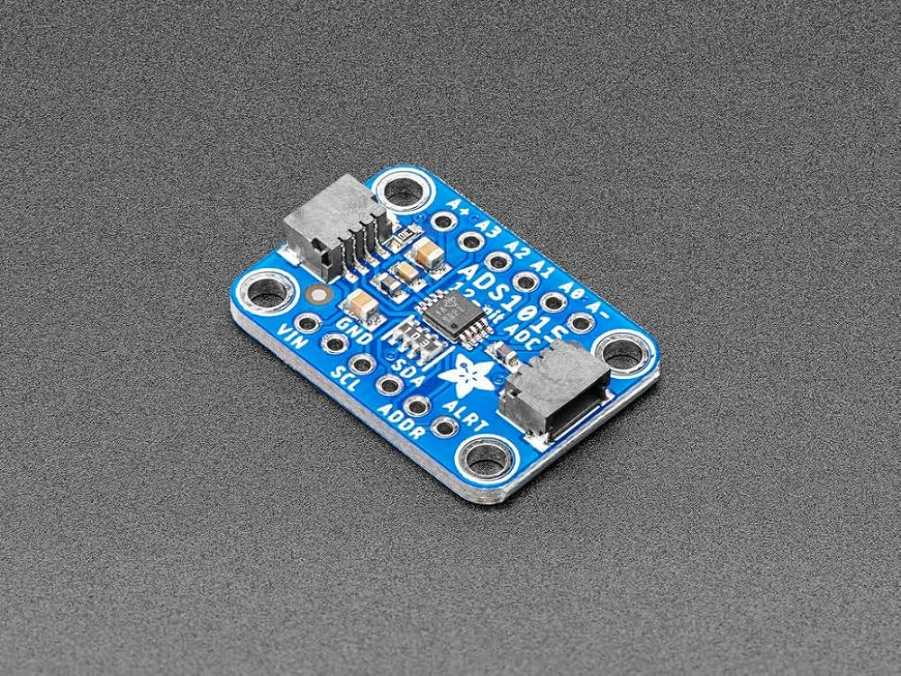
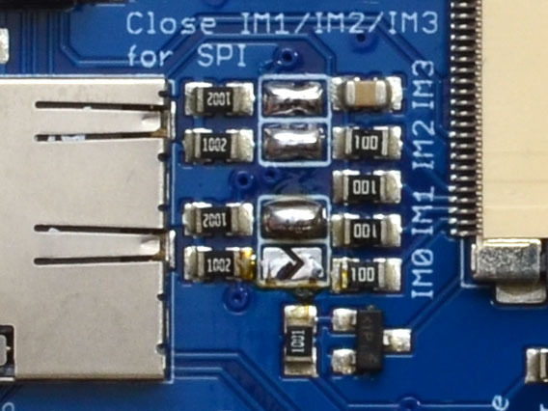
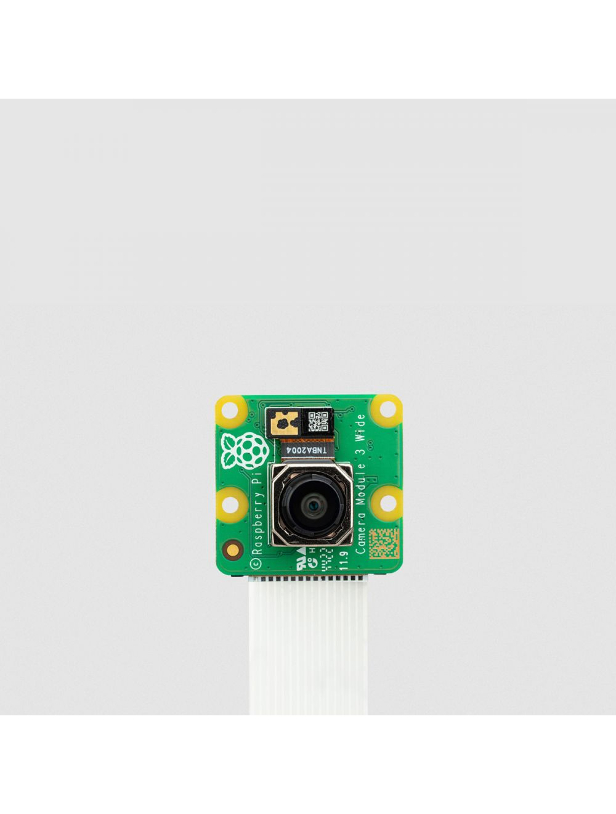
RPi Implementation
Alternative platform without the need for a more expensive operating system platform like a PC.
Raspberry Pi 4B
4 GB RPi board
Raspberry Pi Camera Module 3
12 MP camera with autofocus.
OLED Display/Touchscreen
Display uses SPI mode for serial communication (requires soldering on back panel)
Touchscreen uses 4 wires, replaces the need for push buttons.
Analog Digital Converter
Converts analog data from touchscreen to I2C serial communication.

Slide 19
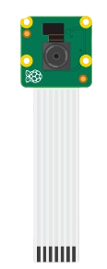
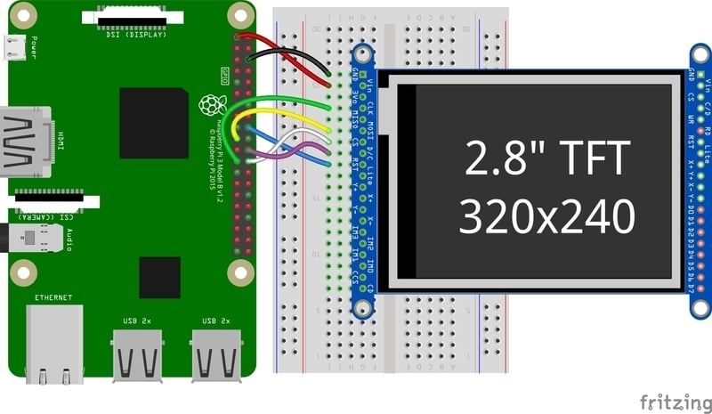
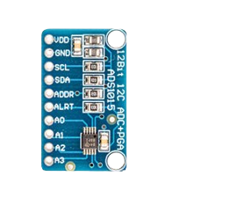

Slide 20
BOM
Part Name | Par Number | Total Quantity | Unit Cost
Raspberry Pi 4B | PI4-4GB | 1 | $55.00
Raspberry Pi Camera Module 3 Standard - 12MP Autofocus | RSP-CAM-V3 | 1 | $25.00
2.8" TFT LCD with Touchscreen Breakout Board | ILI9341 | 1 | $29.95
Lock-style Solenoid | 1512 | 1 | $24
12-Bit ADC - 4 Channel | ADS1015 | 1 | $9.95
Total: $143.9

